Slide 1




PASSWORD MANAGER
MEMBERS:
16010121081 – SHIVOM KARNAD
16010121084 – AYUSH KHANDARE
16010121096 – KEDAR KULKARNI

Slide 2

PROJECT DESCRIPTIPON
Password Manager is a simple but very handy tool to generate strong random passwords with a user defined criteria and store them in an encrypted hidden file. It will be only accessible if master username and password is entered correctly.

Slide 3

PROBLEM STATEMENT
Write a program in Python that generates a strong random password. Also it should contain save option to save the generated password. And saved password should be encrypted and accessable only after Master Login by user.

Slide 4

System Architecture
In total the program is divided into two parts to make it easier to bug fix and understand. The parts being main.py and UI.py (UI.py cannot be renamed without changing main.py).
main.py contains the inner working of the code. File handling, encryption, decryption, password generation and management is handled in main.
UI.py is a User Interface file. It has a total of 6 major functions which handle the 6 different types of UI windows. The entire UI is made with the help of tkinter and serves as a module to be imported into main.

Slide 5
SYSTEM ARCHITECTURE
main-UI integration is handled in the main.py file in the various functions. It can be said that the UI.py is an extension of main.py as in, UI.py functions take the inputs from the user and then pass it onto the main.py functions. For every main.py function that requires a user input, there is a UI.py function that is called to do the same.

Slide 6
Key Features
Exception Handling
Random Password Generator
Random Password Manager
Simple Encryption (Fixed Key)
Login Verification
Crash and bug resistant

Slide 7
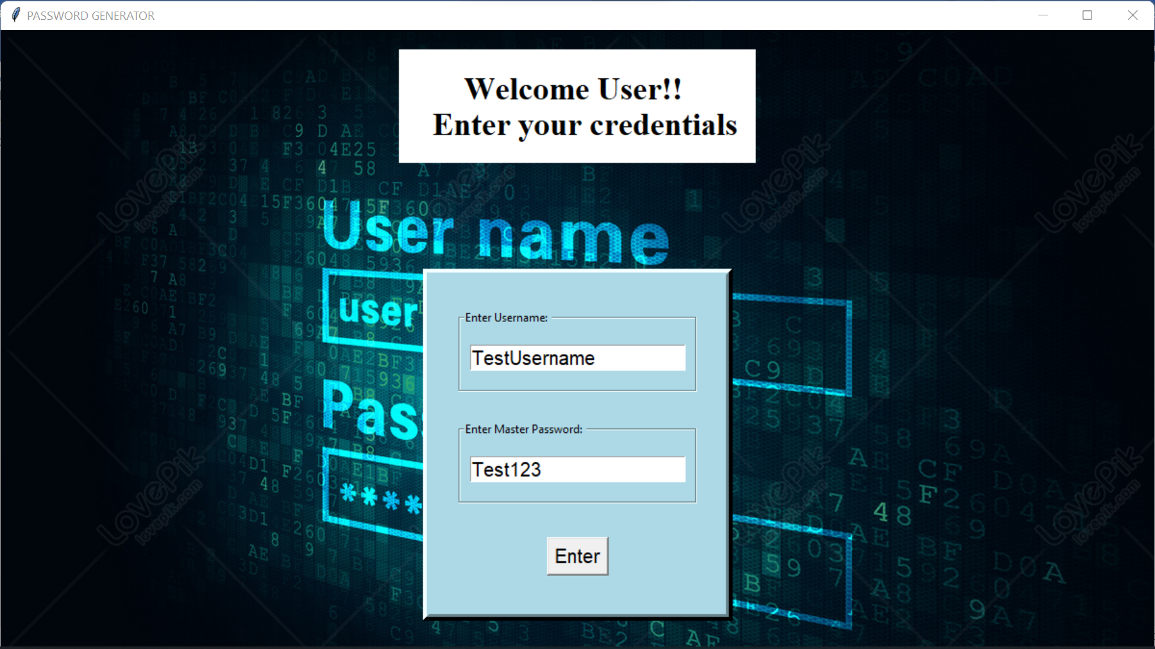
Glimpse Of Project

Slide 8
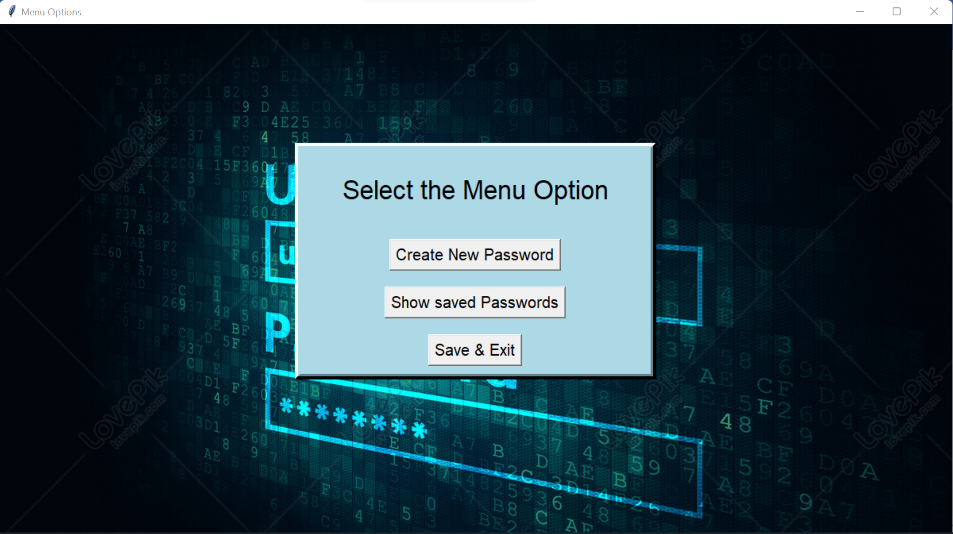
Glimpse Of Project

Slide 9
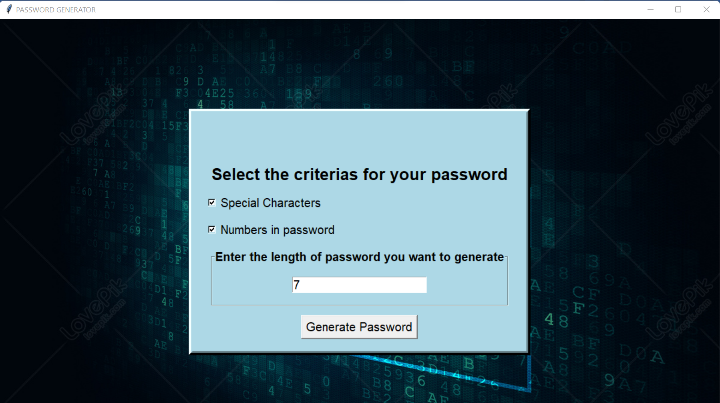
Glimpse Of Project

Slide 10
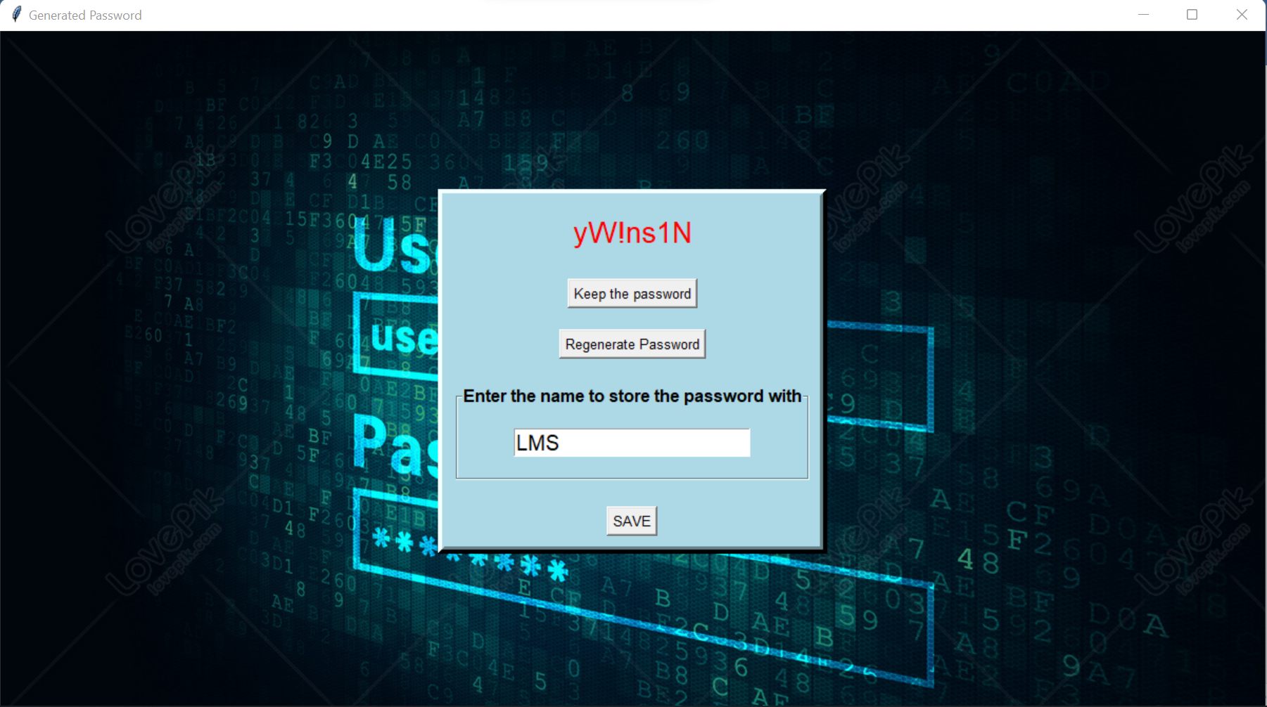
Glimpse Of Project

Slide 11
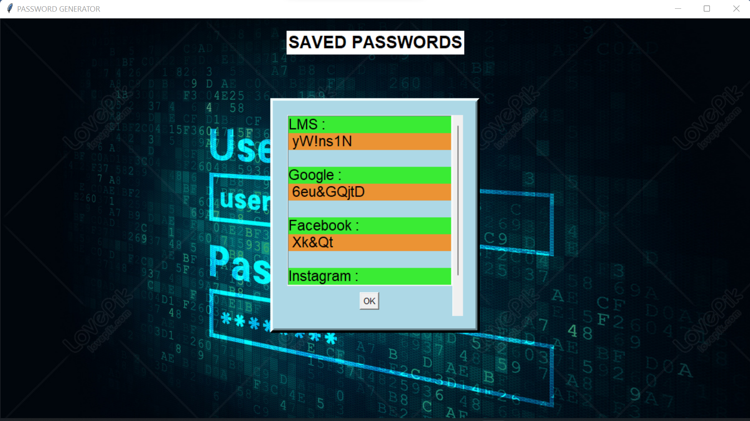
Glimpse Of Project

Slide 12
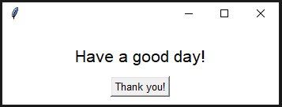
Glimpse Of Project

Slide 13
CONCLUSION
We were able to make multifunctional password manager.
We studied various new things in this project like tkinter, simple encryption(single key), to create master login.
We came across many features of python during research of this project.
We got to know how frontend and backend is integrated.

Slide 14
REFERENCE
https://www.geeksforgeeks.org/encoding-and-decoding-base64-strings-in-python/
https://www.geeksforgeeks.org/python-gui-tkinter/

